Slide 1
Getting Involved in SoCal FIRST ® Tech Challenge 7th-12th Grades in Southern California July 2016

Slide 2
How We Can Grow Together
FIRST ® and FIRST ® Tech Challenge in Southern California
Geography and League Play
Directions to Expand STEM Pipelines and Opportunities

Slide 3
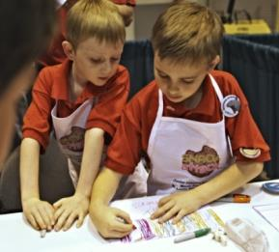
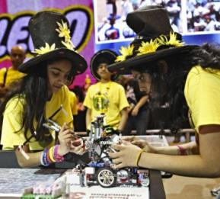
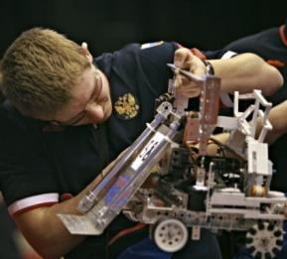
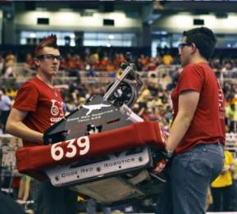
FIRST ® Is…
Inspiring youth to become science & technology leaders & innovators,
by engaging them in exciting, experiential, Mentor and project-based programs
that teach science, technology, engineering, and math (STEM) skills, inspire innovation, and foster well-rounded life capabilities.
Notes:
Projected gap of millions of engineers in a generation
Under representation of women and minorities in STEM fields
The world economy is run by STEM

Slide 4
FIRST ® Impact: More Than RobotsSM
STEM Awareness, Skills and Intent
Increase the number of students who pursue post-secondary education and careers in STEM-related fields and industries
Innovation and Entrepreneurship
Inspire youth to become leaders and innovators in their field and society
21st Century Work-Life Skills
Enable young people to develop valuable, transferrable, real-world skills, including: teamwork, leadership, creative problem solving, critical thinking, time & project management, and communication/presentation skills

Slide 5
FIRST ® At-a-Glance
400K
students participating
in 2015-2016
200K+
Mentors, Coaches, Judges & Volunteers in 80+ countries
16M+ Volunteer hours served
in 2015-2016
$25M+
scholarship opportunities from nearly 200 providers
>2,200
official events worldwide
41K+
participants at annual FIRST ® Championship

Slide 6
FIRST® is More than Robots®

Slide 7
FIRST ® : Inspire, Transform, and Engage
Vision
To transform our culture by creating a world where science and technology are celebrated and where young people dream of becoming science and technology leaders.
Dean Kamen, Founder
Mission
To inspire young people to be science and technology leaders, by engaging them in exciting Mentor-based programs that build science, engineering, and technology skills, that inspire innovation, and that foster well-rounded life capabilities including self-confidence, communication, and leadership.
Methodology
Engage kids in kindergarten through high school in exciting, Mentor-based, research and robotics programs that help them become science and technology leaders, as well as well-rounded contributors to society.

Slide 8
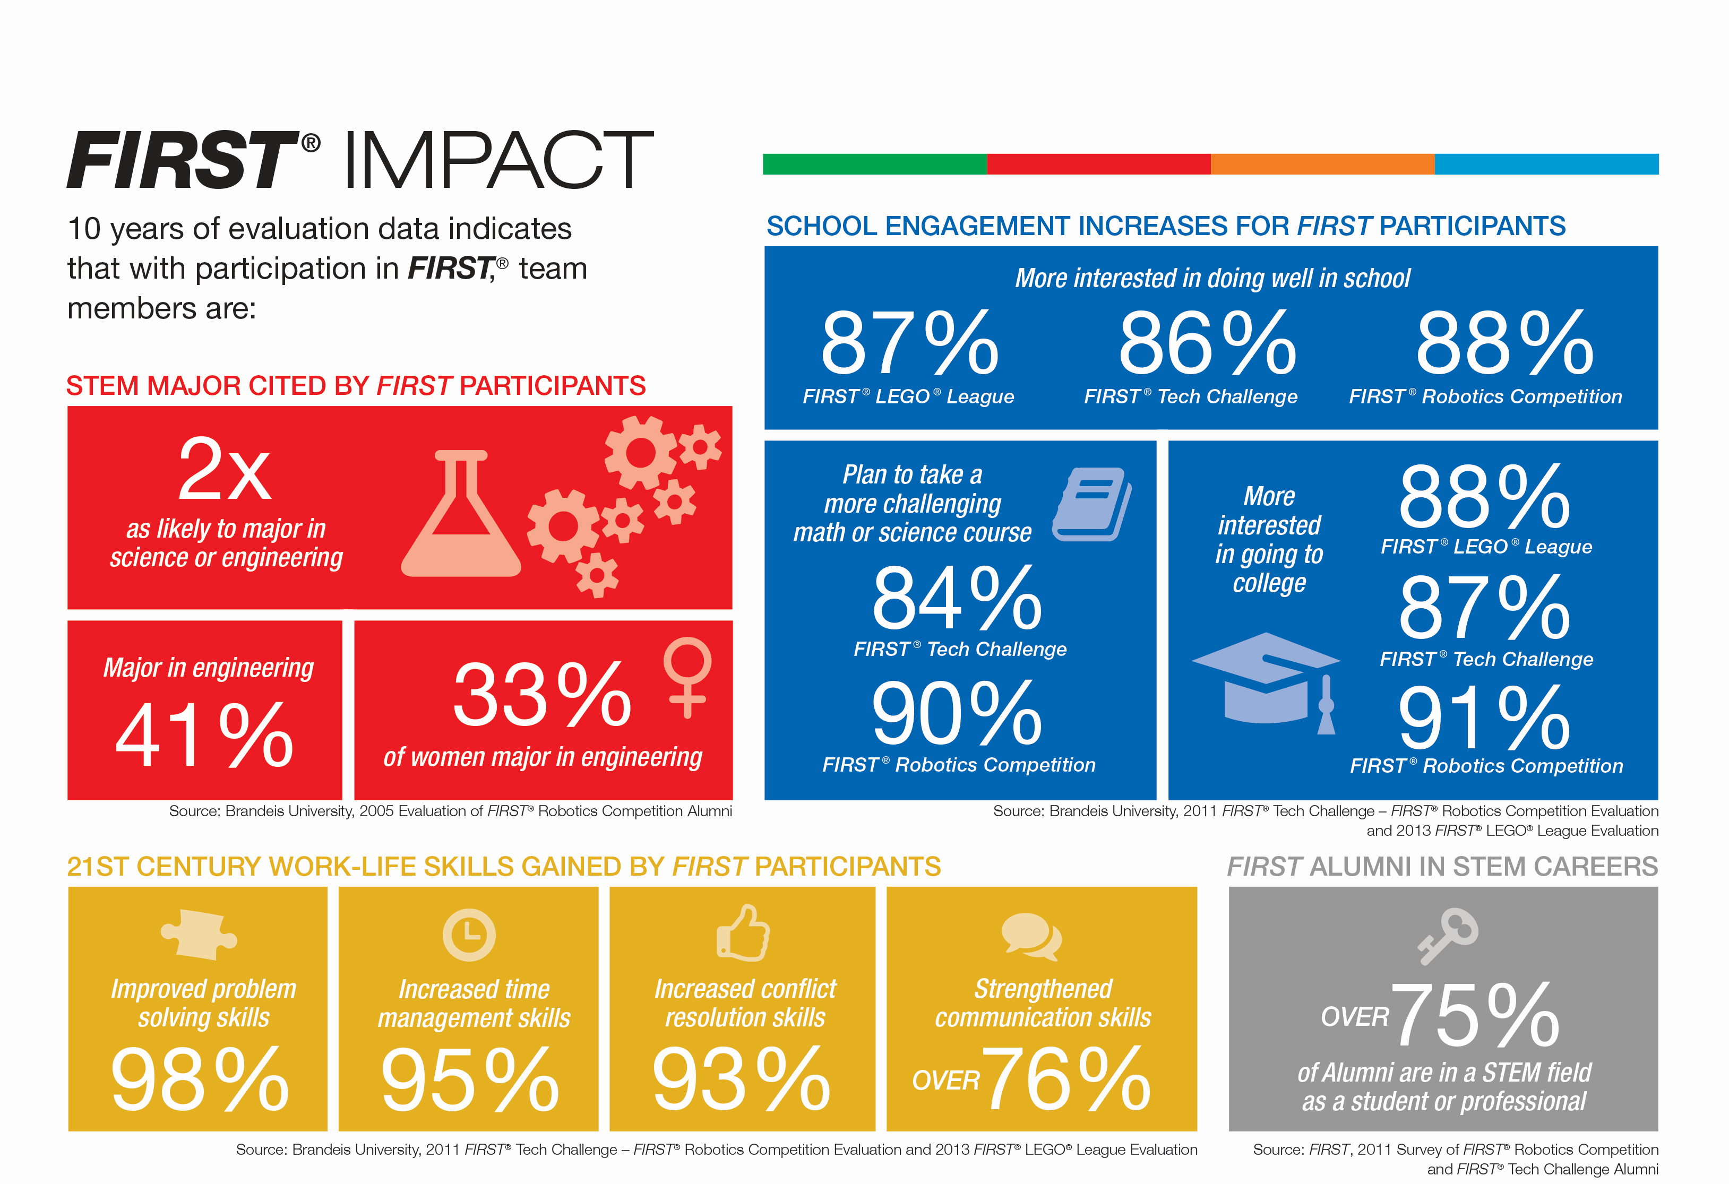
FIRST Impact

Slide 9
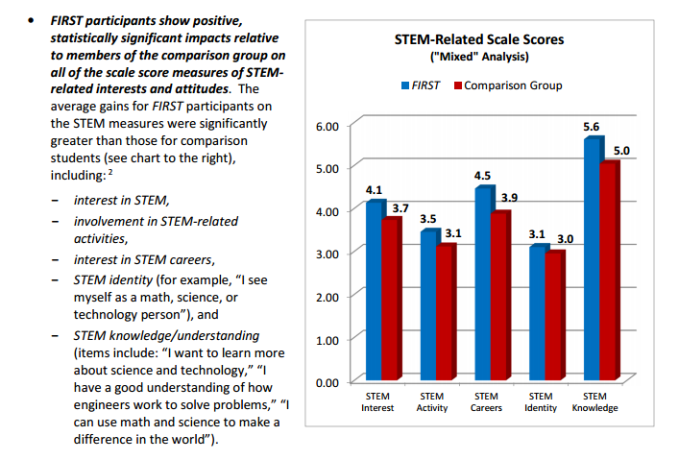
Impacting STEM Interests and Attitudes
March 2016, “FIRST Longitudinal Study: Findings at Follow-Up (Year 3 Report)”. The Center for Youth and Communities Heller School for Social Policy and Management Brandeis University Waltham, MA

Slide 10
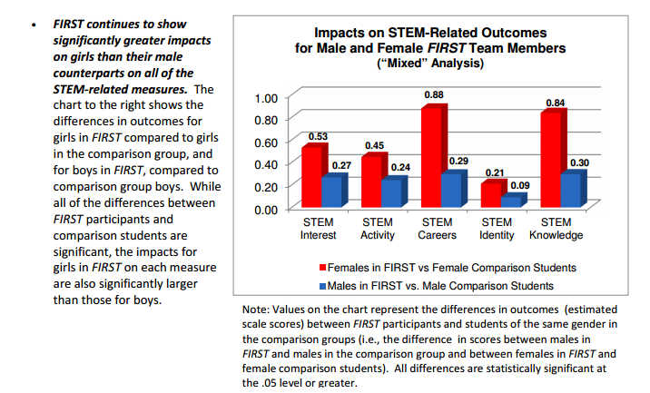
Accelerating Female Interests and Identities
March 2016, “FIRST Longitudinal Study: Findings at Follow-Up (Year 3 Report)”. The Center for Youth and Communities Heller School for Social Policy and Management Brandeis University Waltham, MA

Slide 11
Part of the FIRST ® Progression of Programs
FIRST ® learning never stops building upon itself, starting at age 6 and continuing through middle and high-school levels up to age 18. Young people can join the international, K-12, after-school, STEM programs at any level.
FIRST inspires innovation excellence, teaching 21st century skills, and immersing participants in project-based learning and robotics competitions.
Link to the three other programs in Appendix

Slide 12
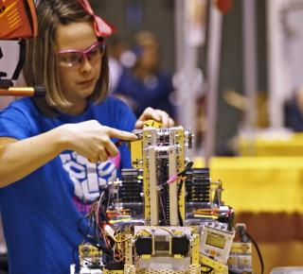
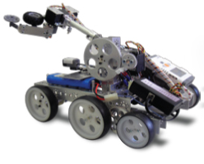
Teams of 7th-12th grade students
Develop strategy, design and build sophisticated robots
Use a modular kit-of-parts and custom built additions
Compete head-to-head with and against different teams of students

Slide 13
Team-Driven Learning
Life-changing experience – More than Robots ®
2-15 students plus min. 2 adults per team
Sept. through Feb. local season, with possible advancement to Super-Regional and Worlds
Student-driven, iterative, project-based learning model
Mentor-supported; mentors do NOT need to be technical experts
Variety of options: in-class, after school, and community groups
$2,000-3,000 first-year to launch; reusable platform, powered by Android technology and programmed using Java
Need-based grants available from communities, Region, and National support for rookies and beyond
Free curricular first-year materials for teachers based on sound design and engineering principles
Soft-skills in addition to robot design, programming, and construction
Entrepreneur-based – learning beyond robots to change their own worlds and abilities, and with their communities
Soft skills, including strategic problem-solving, organization, and team-building skills
Awards for competition, community outreach, and design
More than $20 million in individual scholarships

Slide 14
SoCal Dynamics
136 Teams across 9 Counties (2015-16): Los Angeles, Orange, Kern, Ventura, San Bernardino, San Luis Obispo, Santa Barbara, Imperial, and Riverside Counties
Est. 1,500 students, ages 12-18 (Grades 7-12); average 11 students per team
Possible engagement: 1,400 public and private schools
~50 Meets, 5 InterLeague Tournaments, Qualifying Tournaments, Regional Championship
Supported by alt-NEXT, a 501c3 organization, and a dozen adult volunteers, plus team mentors and schools
Peer to NorCal (130 teams) and San Diego (60 teams) Regions

Slide 15
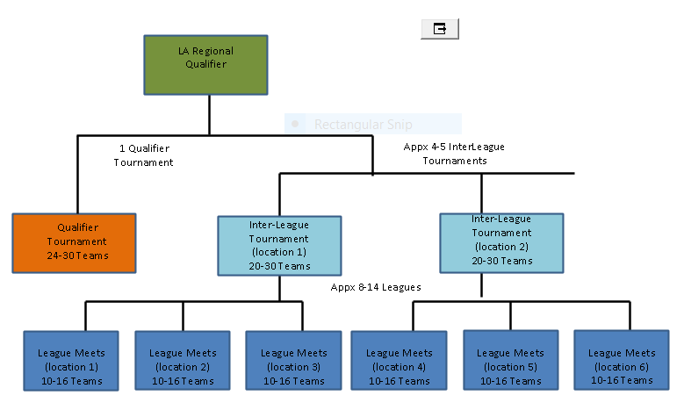
2016-2017 Season Timing
Sept. 10 Game Kickoff (Monrovia, CA)
Dec. - Jan. League Meets (Locations TBD)
Meet 0: December 3 or 4, 2016
Meet 1: December 17 or 18, 2016
Meet 2: January 7 or 8, 2017
Meet 3: January 21 or 22, 2017
January 1-2 Qualifier Tournaments (Location TBD)
Jan. - Feb. 4-6 InterLeague Tournaments (Locations TBD)
January 28/29
February 4/5
and/or February 11/12
Feb. 26 LA Regional Championship (Monrovia, CA)
Mar. 10-12 West Super-Regional Championship (Tacoma, WA)
April 19-22 World Championship (Houston, TX)

Slide 16
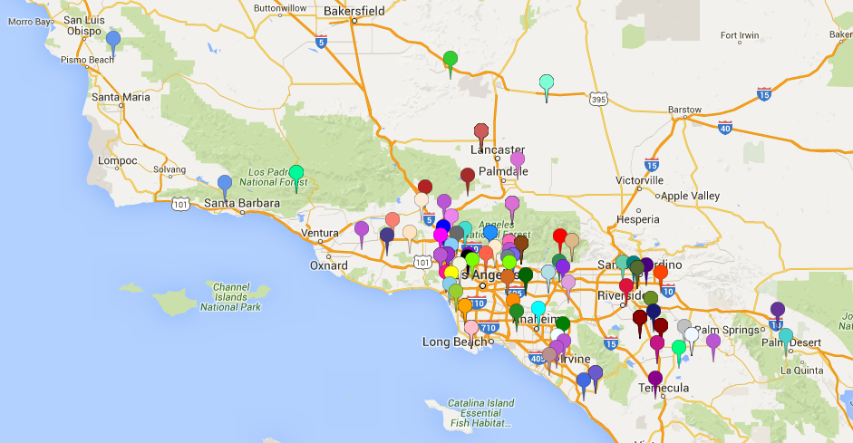
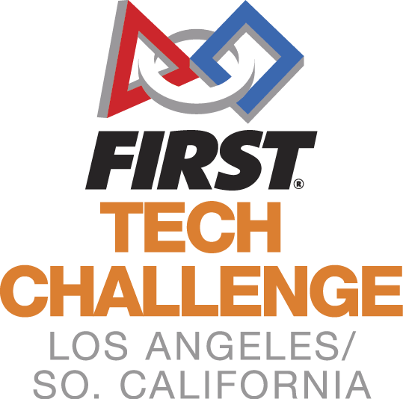
Our Cities and Communities (2015/16)

Slide 17
Our Growth: Leagues Near Schools
League (Initial Name) | Cities (examples)
Zone A | Los Angeles, Hollywood
Zone B | Santa Monica, Westchester, El Segundo, Torrance, Cypress, Pico Rivera, Cerritos, Long Beach
Zone C | La Canada, Monrovia, Pasadena, Temple City, Rosemead, Glendale, San Gabriel
Zone D | West Hills, North Hills, San Fernando, Newhall, Sun Valley, Valencia, Thousand Oaks, Agua Dulce, Van Nuys, Sherman Oaks, North Hollywood, Simi Valley, Camarillo
Zone E | Chino Hills, Claremont, Hacienda Heights, La Verne, Pomona, Walnut
Zone F (2 Leagues min) | Cathedral City, Palm Desert, Grand Terrace, Bloomington, Colton, Loma Linda, Redlands, Hemet, Moreno Valley, Perris, Menifee, Rialto, Romoland, Temecula, Winchester
Zone G | Irvine, Newport Coast, Anaheim, San Juan Capistrano
Zone H | Ojai, Santa Barbara, Arroyo Grande, Ventura, San Luis Obispo
Zone I | Edwards, Lancaster, Quartz Hill, Palmdale, Tehachapi

Slide 18
Core Opportunities
Sharing Support to Grow STEM Leaders
Mentor/Teacher Support –Subject Matter Experts in programming, design, CAD, public relations, public speaking, machine shop, video production
Possible locations for League Meets (1/2-day events for 10-15 teams) or InterLeague Tournaments (24 teams for one weekend day)
Team Support – helping 7th-12th graders directly
Volunteer recruitment for our est. 60 events in 9 counties
Central Volunteers – esp. in regional marketing and school recruitment
College Recruitment for potential great students with our local college
Connection with Engineering student groups for outreach and service projects

Slide 19
Our FIRST ® Community All Benefits
For Our Students: the hardest fun you’ll ever have
For Mentors, Coaches, Volunteers: the most rewarding adventure you’ll ever undertake
For Partners/Sponsors/Donors: the most enlightened investment in your community you could ever make!

Slide 20
More Information
On the web:
www.socalftc.com
www.firstinspires.org
@SoCal_FTC
Brian Johnson, bjohnson@firstinspires.org (regional Senior Mentor)
Gigi Johnson, EdD, maremel@gmail.com, 626-603-2420
Theresa Klemme, tfklemme@gmail.com

Slide 21
Progression of Programs
Three other great programs: FIRST ® LEGO ® League Jr., FIRST ® LEGO ® League, and FIRST ® Robotics Competition

Slide 22
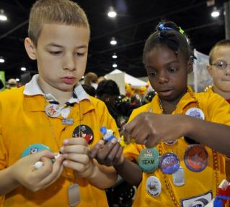
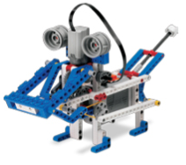
Teams of up to 6 kids build interest in science with a real-world scientific challenge solved by guided research and imagination.
2015/2016 Season

Slide 23
Introduction to science and technology
Design and build Challenge-related model using LEGO ® elements
Create a Show Me poster and practice presentation skills
Explore challenges facing today’s scientists
Discover real-world math and science
Engage in team activities guided by FIRST ® LEGO ® League Jr. Core Values

Slide 24
2015/2016 Season
6,800+ teams (projected)
40,500+ children, ages 6-9 (Grades K-3)
Up to 6 students per team
250+ local Expos, 1 World Festival Expo
29 countries

Slide 25
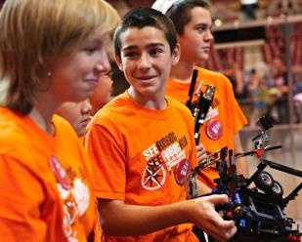
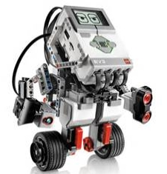
Teams of up to 10 kids build
LEGO®– based robots and develop research projects based on a real-world scientific challenges.
*Ages vary by country
2015/2016 Season

Slide 26
Create innovative solutions to challenges facing today’s scientists
Strategize, design, build, program and test an autonomous robot using Challenge-related model using LEGO ® MINDSTORMS ® technology
Apply real-world math and science concepts
Develop career and life skills
Become involved in their local and global community

Slide 27
Team Growth
2015/2016 Season
29,000+ teams (projected)
233,000+ students, ages 9-16* (Grades 4-8)
Average 8 students per team
1,218 Qualifying Tournaments, 153 Championship Tournaments, 1 World Festival
Approx. 80 countries
*Ages vary by country
U.S. & Canada
Outside U.S. & Canada

Slide 28
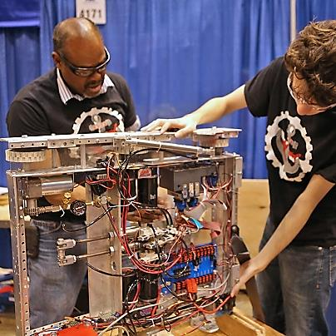
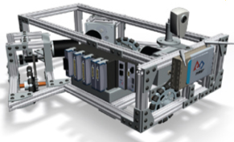
Teams of 25 (average) or more students compete with 120-pound robots in this Varsity Sport for the Mind,TM combining the excitement of sports with the rigors of science and technology.
2016 Season

Slide 29
Strict rules, limited resources, time limits
Students mentored by professional engineers
Learn and use sophisticated hardware and software
Build and compete with robots of their own design
Develop design, project management, programming, teamwork, strategic thinking, and Coopertition® skills
Qualify for >$25 million in scholarships

Slide 30
2016 Season
3,100+ teams
78,000+ high-school-age students
10 or more students per team (average 25)
53 Regionals, 8 District Championships; 65 District Competitions; 1 FIRST Robotics Competition Championship
24 countries

Slide 31
Connecting to Southern California FIRST® Programs
FIRST® LEGO ® League Jr.
Inland Empire, Orange County: Lynn Crocket, lynn.crockett@legoland.com
San Luis Obispo, Santa Barbara, Ventura: Ty Fredriks, tfredriks@firstinspires.org
FIRST® LEGO ® League
Los Angeles: Tony Ayad, tony.ayad@gmail.com
Inland Empire, Orange County: Lynn Crocket, lynn.crockett@legoland.com
Kern County: Callie Carbajal, calliecarbajal@cvrobotics.org
FIRST® Robotics Competition
Los Angeles: Velma Lomax, vlomax@firstinspires.org
San Luis Obispo, Santa Barbara, Ventura: Ty Fredriks, tfredriks@firstinspires.org
Inland Empire, Orange County: Rick Sisk, rsisk@firstinspires.org

