Slide 1
Inclusion
What does this mean?

Slide 2
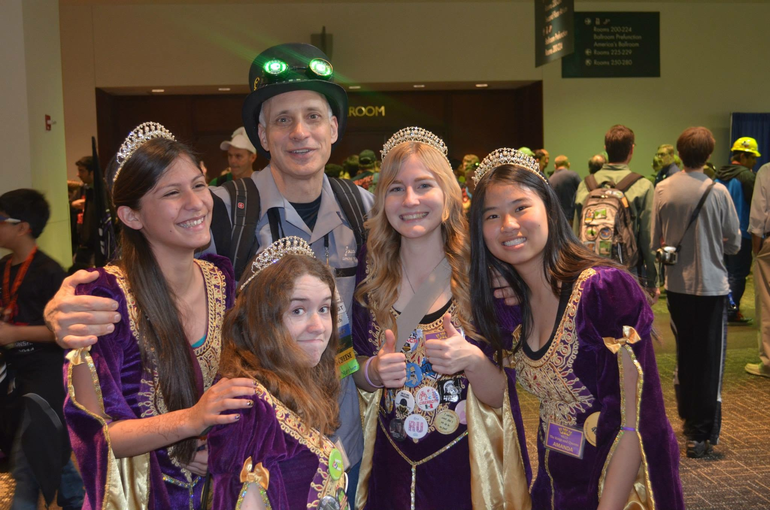

Slide 4
What do you see?

Slide 5
Different Types of People

Slide 6
Minority Groups
Women
Minorities
LGBTQ+
Low Income

Slide 7
Women and Minorities in STEM
Very few all-girl team or at least 50% of team
Hard to encourage girls to join
Feeling awkward and uncomfortable

Slide 8
Minorities
Different Races
Nationalities
Culture

Slide 9
Low Income
Access
Exposure
Understanding

Slide 10
LGBTQ+
Differing opinions about the community
LGBTQ+ of FIRST
Teams can become ambassadors (3526)
How to make them feel welcome
Comments and Language
Coming Out?

Slide 11
How to deal with being on a team?

Slide 12
Common Points of Conflict
Differing Ideas and Opinions
Feeling Different
Other Commitments
Personal Lives

Slide 13
Differing Ideas
Not All Agree
Fighting leads to negative all around experience
People quit
Drama
Dating
Outside Information
Gossip
Not liking someone

Slide 14
Feeling Different
Being the odd one out
Appearance
Liking different things
Social Skill level

Slide 15
Other Commitments
Sports
Family
Work

Slide 16
Personal Lives
Mental Health
Dating
Personal Beliefs or Opinions
Home Life

Slide 17
Mental Health
Why does it matter?

Slide 18
Different Types of Mental Health
ADD, ADHD
Social Anxiety, Anxiety
Depression
Bipolar
Schizophrenia
OCD
Autism Spectrum
Aspergers

Slide 19
How To Deal With Them/ People
Understanding
Respect
Know Boundaries

